Slide 1
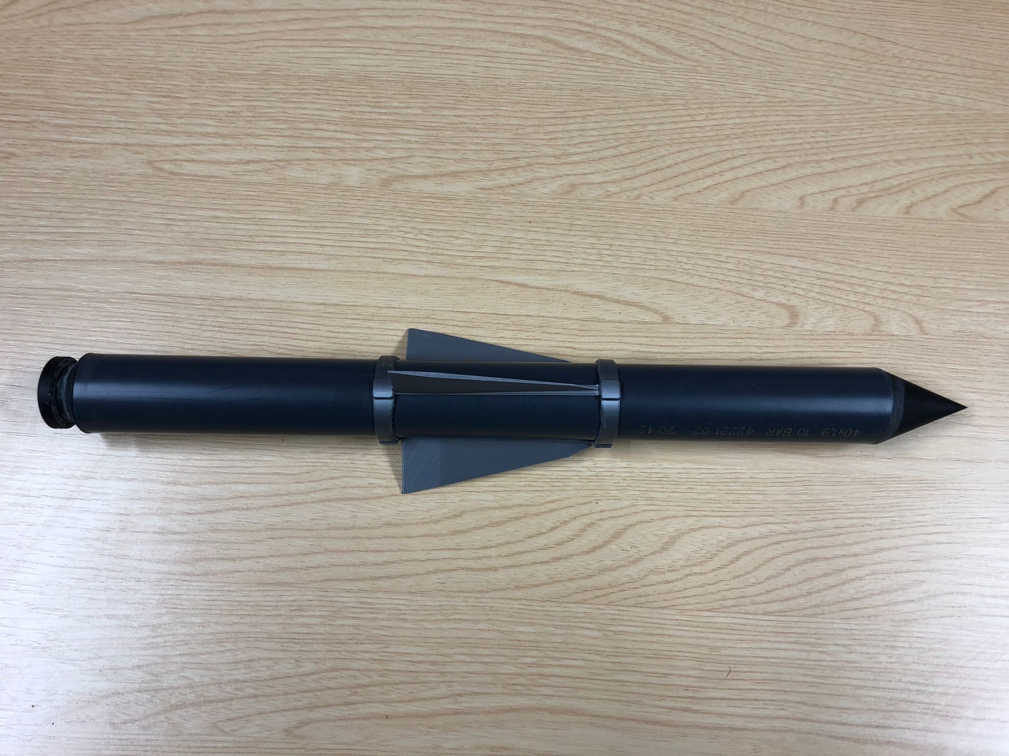
Let’s go to the moon project
Rocket instructions

Slide 2
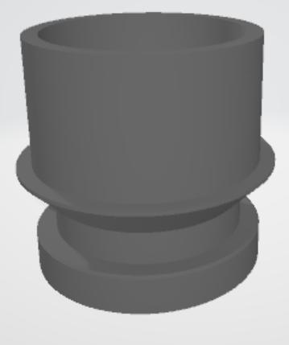
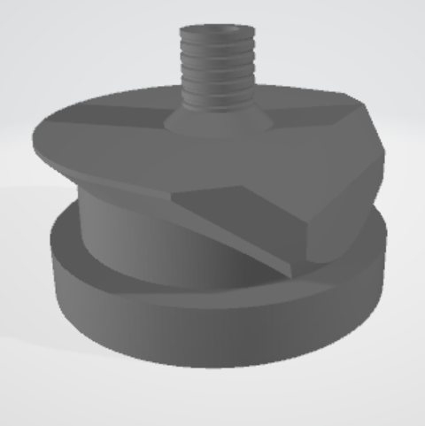
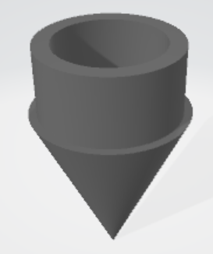
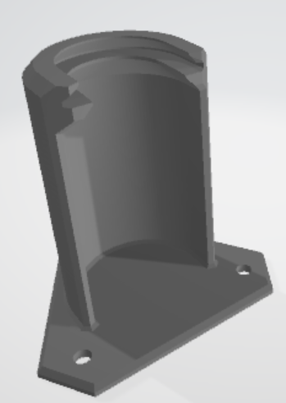
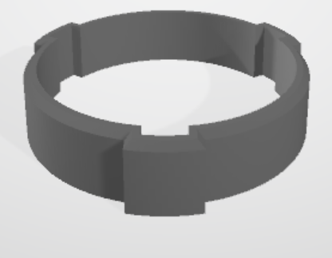
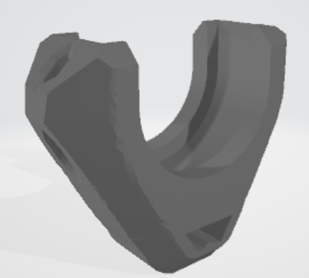
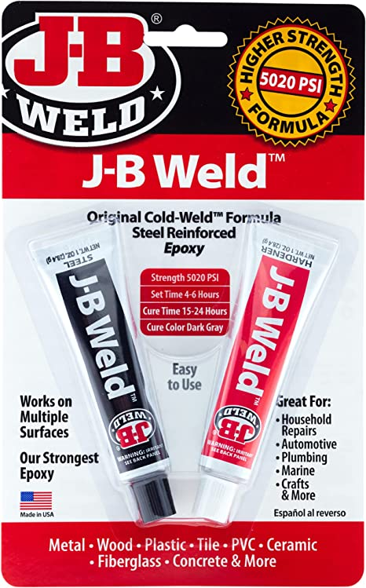
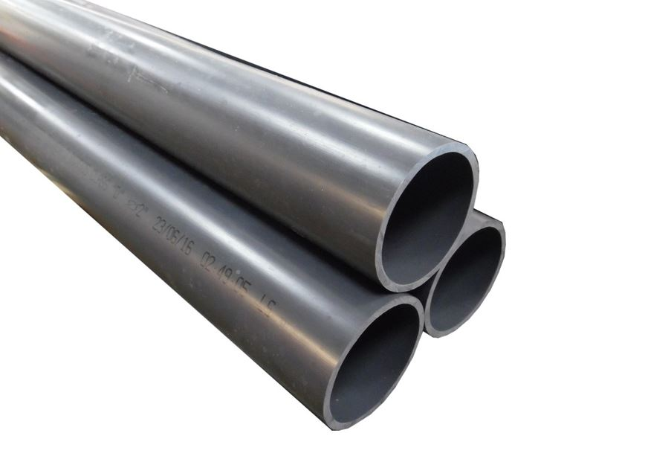
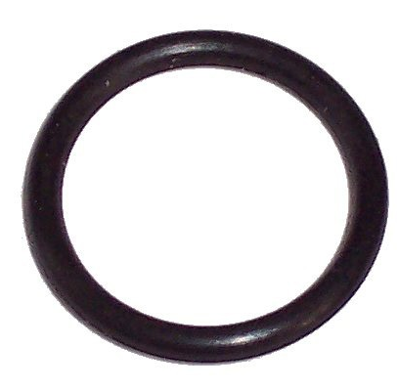
MATERIAL
Printed material for one rocket:
1 inlet: resin or nylon
1 nozzle: resin or nylon
1 pin: resin or nylon
1 nose: resin
1 mount: nylon ideally or resin
3 fins: PLA
2 fins locking ring: PLA
Nozzle
Inlet
Nose
Mount
Fin
Pin
Fin locking ring
Other material:
1 PVC tube: 36mm ID and 40mm OD
1 O-ring to put in the inlet
Epoxy glue to air tight the nozzle and the nose to the PVC tube (we used J-B weld epoxy glue)
A piece of string to attach to the pin
A piece of wood to attach the mount on
A bike pomp with a pressure gage

Slide 3
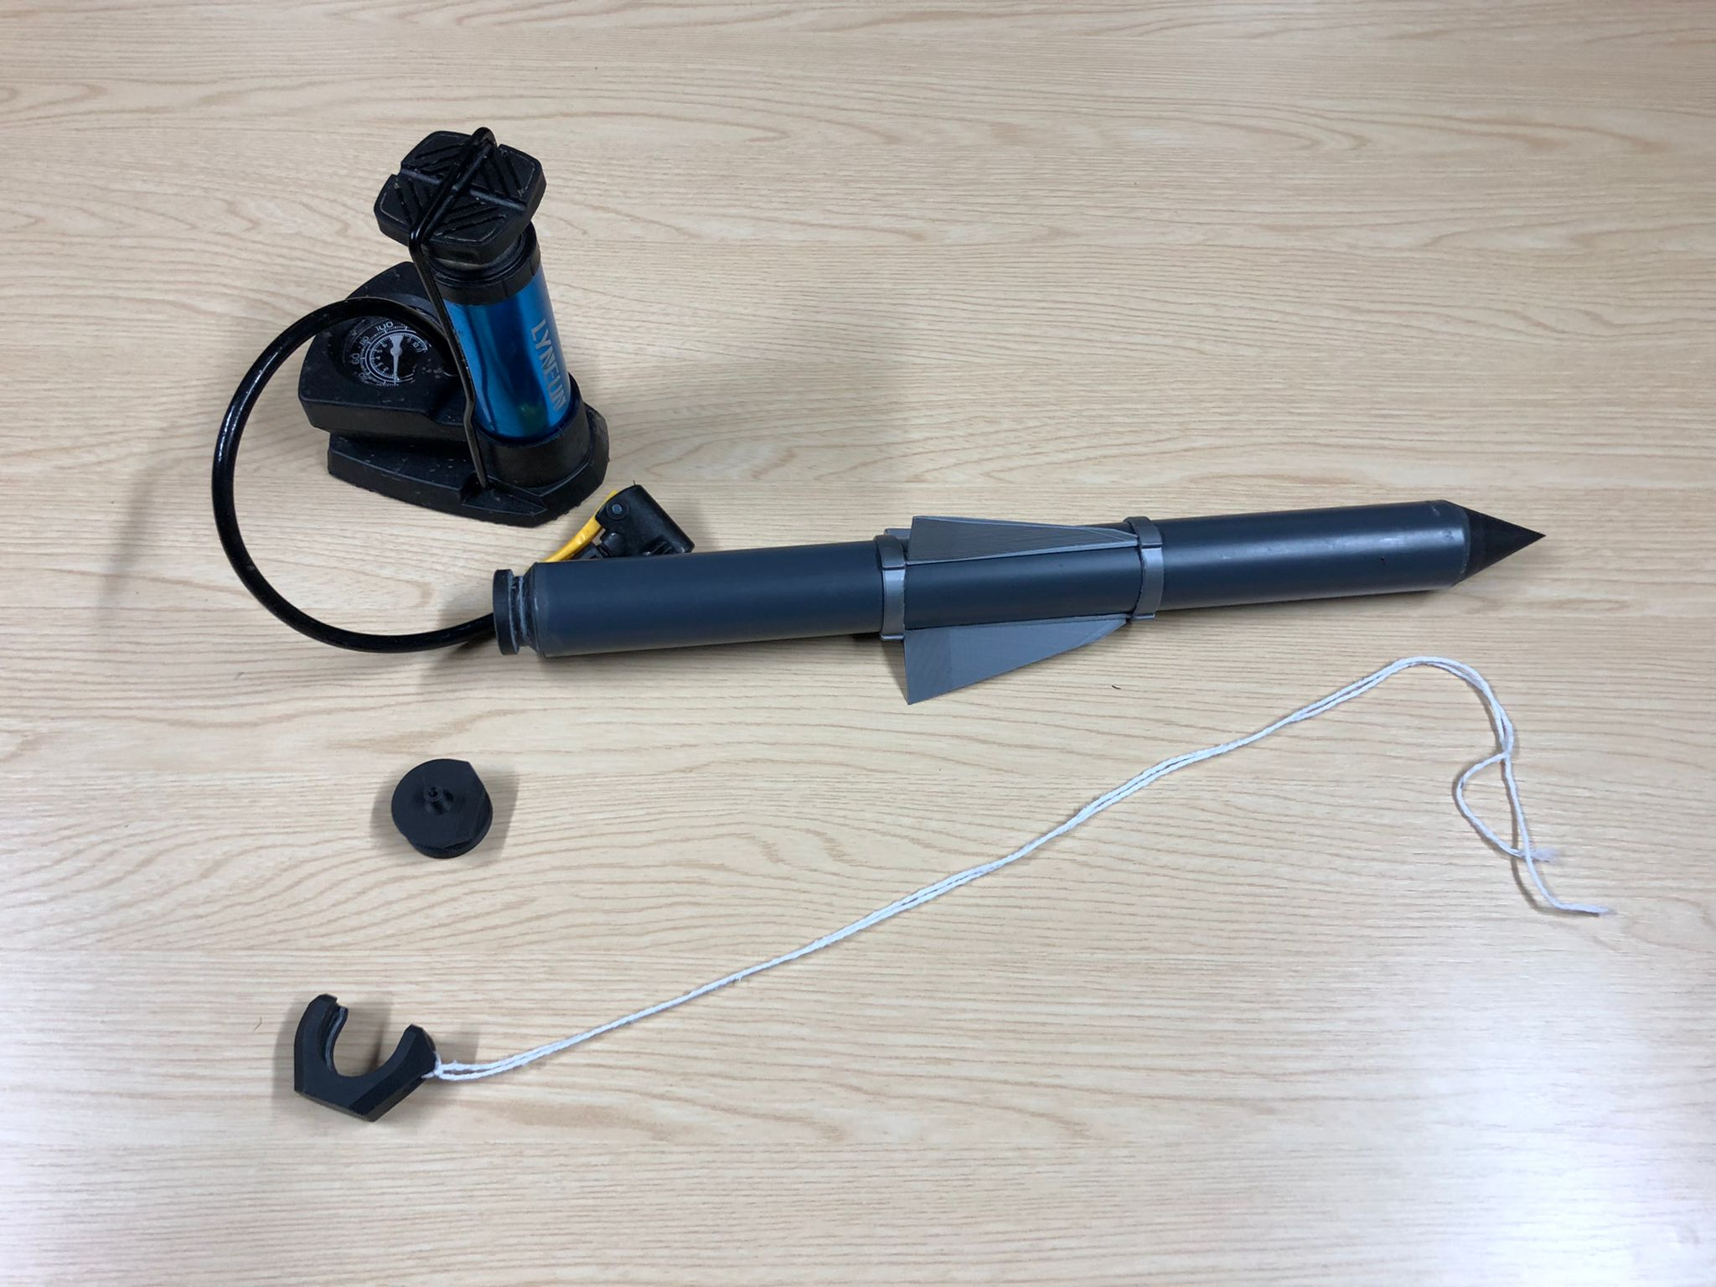
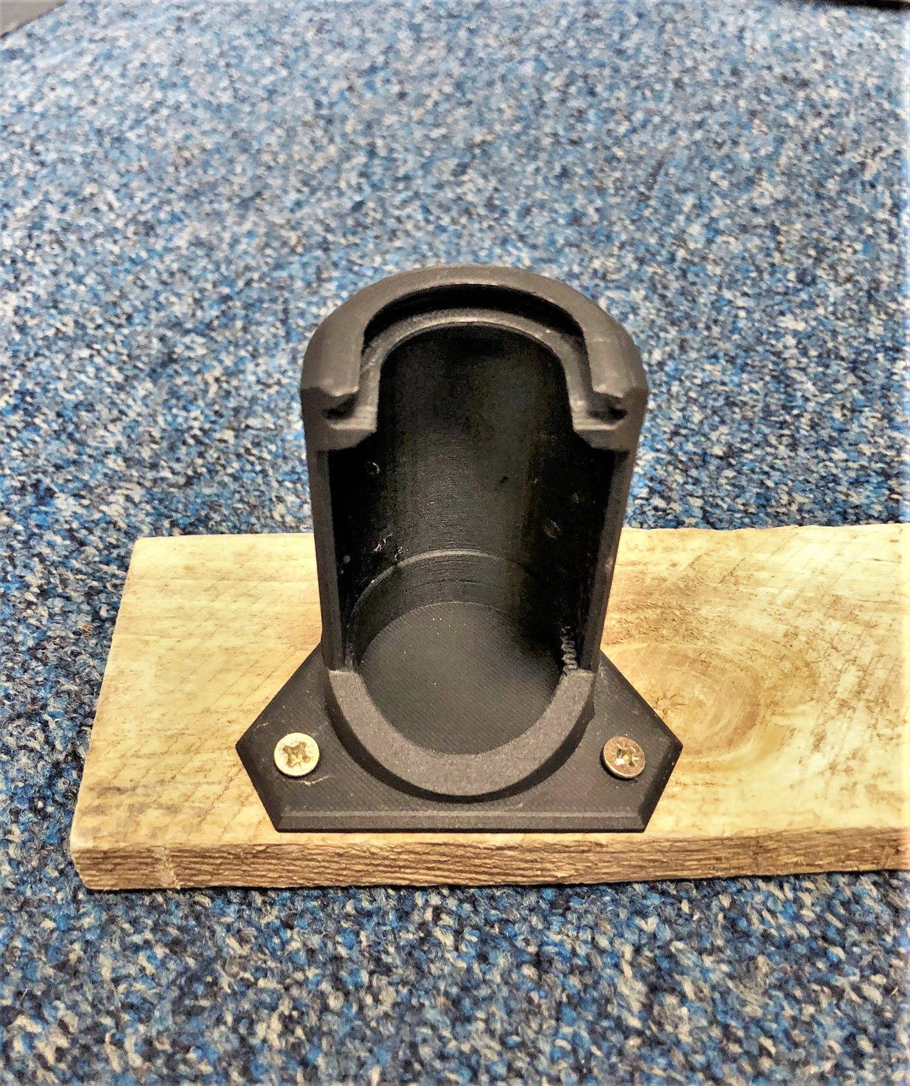
Bike pump
Mount
Fin locking ring
Fin
Nose
Nozzle
Inlet
Pin

Slide 4
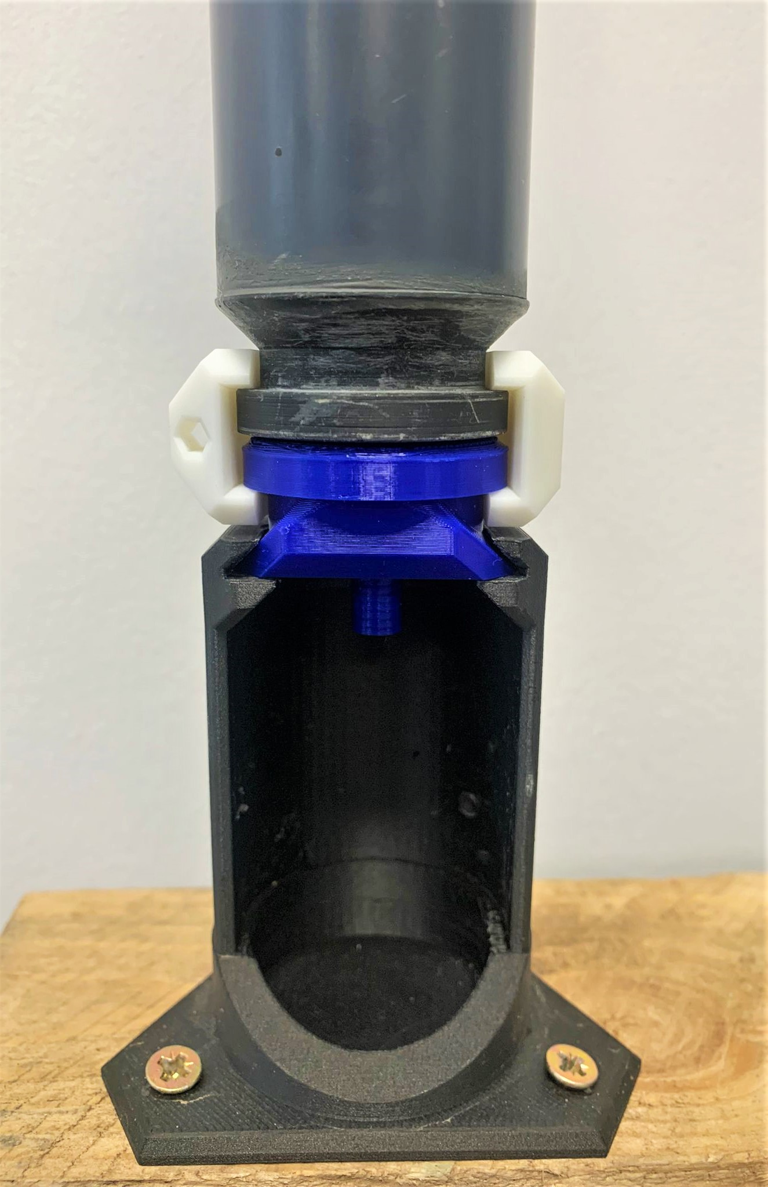
LAUNCH
Rocket
The launch requires two people, one pumping and the other one holding the piece of wood on the group and pulling the pin
Fill the PVC tube with water halfway through (use warm water if it is cold outside…)
Attach the inlet, pin and bike pump while holding the rocket upside down
Slide it into the mount
Build pressure up to ~5bar
Launch the rocket by pulling the pin
Nozzle
Pin
Inlet
Connect to the bike pump
Mount

Slide 5
TIPS/IMPROVEMENTS
The inlet probably needs to be machined to correctly insert the O-ring depending on the ring.
The piece of wood could be pegged into the ground.
We tried rockets with inlet + nozzle + pin in both nylon and resin. The ones printed with nylon tend to leak while the ones printed with the resin tend to be to big and the mechanism is too stiff. The resins ones can be easily grided to make the mechanism smoother. However, resin is much more brittle than nylon and might not last long.
We haven’t tried to print the nose in nylon. That would improve the durability of the rocket as the resin nose is quite brittle. However, as nylon printing is a FFF technique, the part might not be completely air tight and could loose pressure through the filament’s layers.
There is two version of the pin, the first one is not practical to pull, the second one needs some griding because the tolerance is too small.

