Slide 1
Thanks for helping deliver the UKSA ‘Let’s Move to the Moon’ boxes
Here are some slides for the UKSA box DELIVERY session.
The important thing is to make the presentation your own so I have hidden a lot of the slides but feel free to use them if you feel comfortable presenting them.

Slide 2
Let’s Move to the Moon
[INSERT DATE HERE]

Slide 3
[Introduce yourself, add a few interesting images from your research or what you have done]

Slide 4
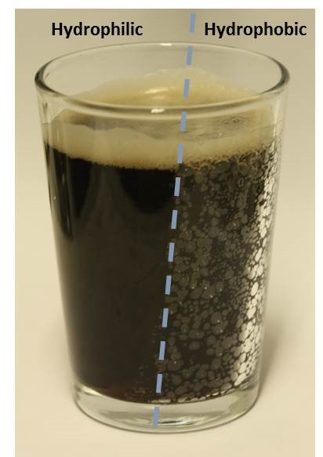
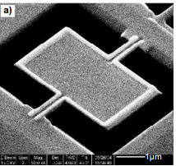
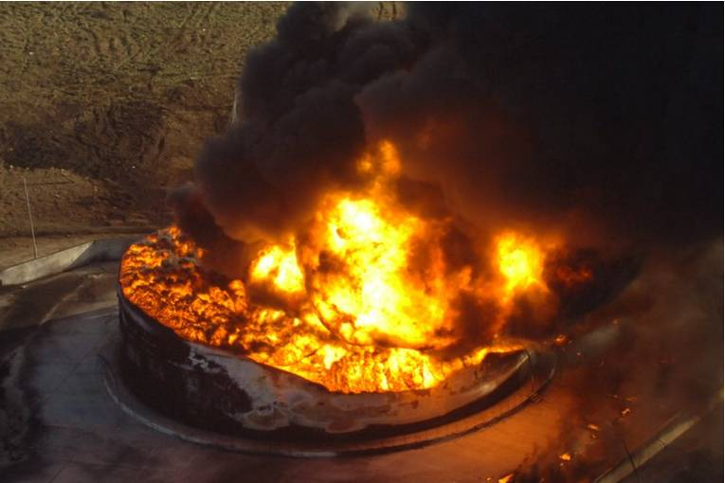
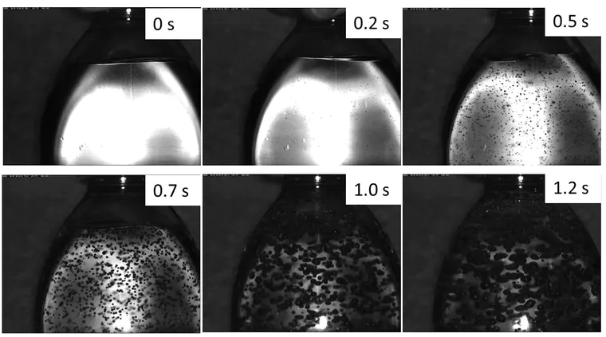
A-levels:
Maths, Physics, Chemistry

Slide 5
What is Materials Science?
Chemistry
Biology
Physics
Materials Science

Slide 6
Materials Science and Engineering
Mechanical
Chemical
Atomic
Electrical
Microscopic
Optical
Structure
Properties
Materials
Component
Engineers
Thermal
Magnetic

Slide 7
[Give a couple of examples of two of structure / property relationships OR take a few demonstrations (e.g. shape memory alloys, ferrofluids) ]

Slide 8
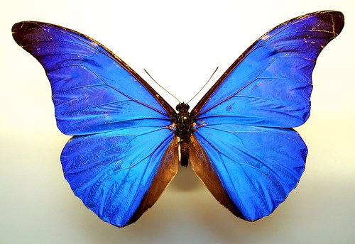
Morpho butterfly

Slide 9
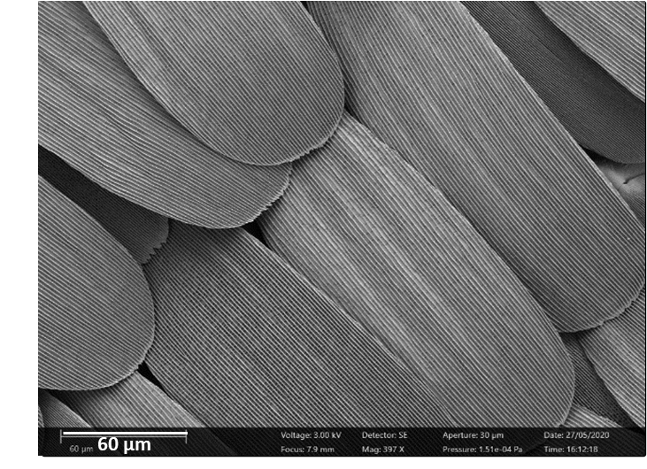

Slide 10
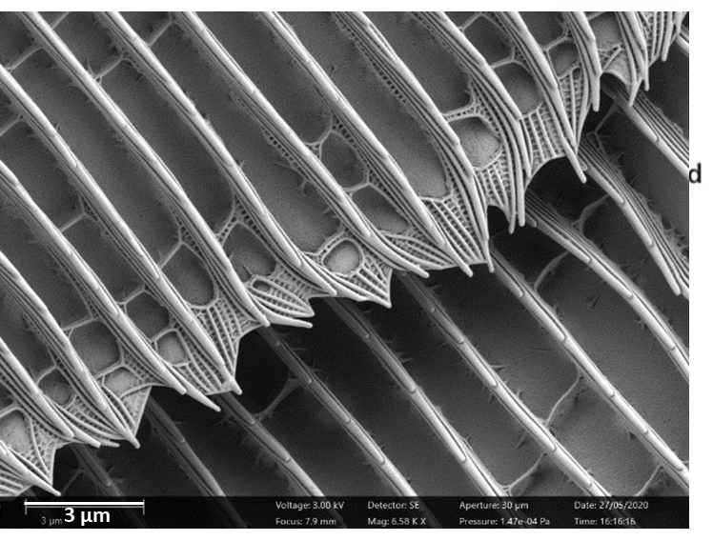

Slide 11
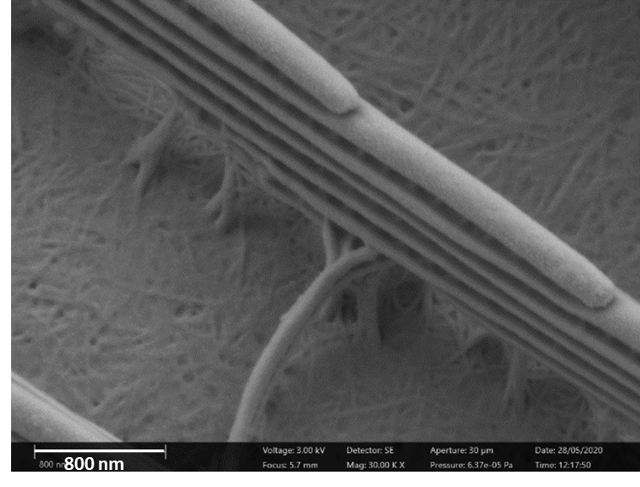

Slide 12
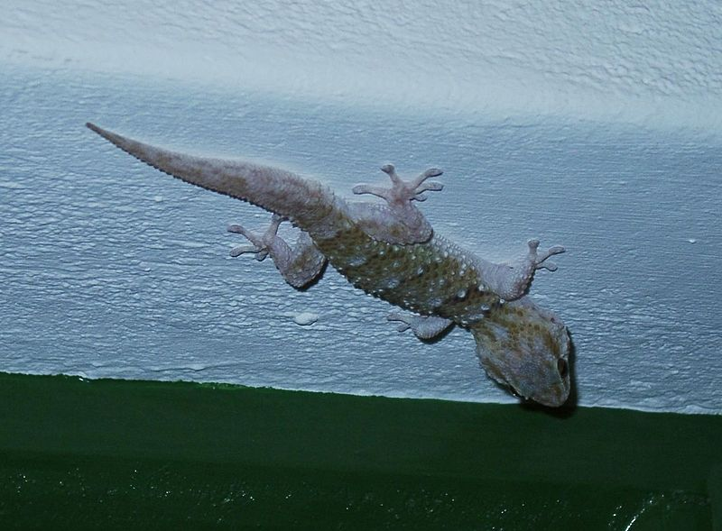
Gecko

Slide 13
Lotus
v
Holly
Photo by Kari Shea on Unsplash

Slide 14
Lotus leaf

Slide 15
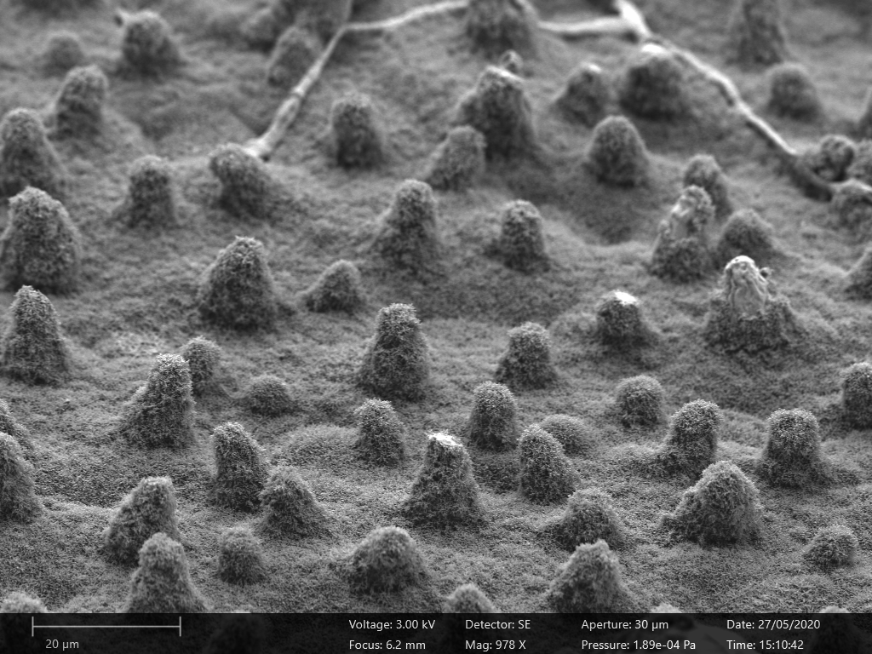
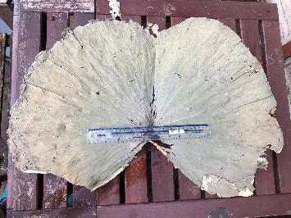
20 µm

Slide 16
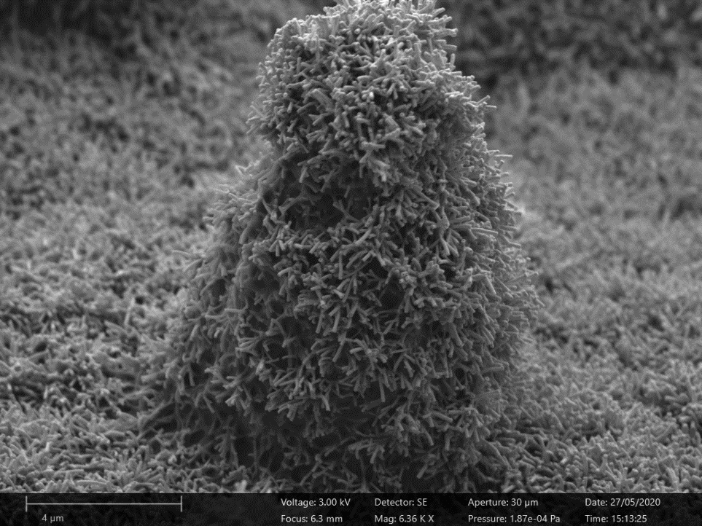
4 µm

Slide 17
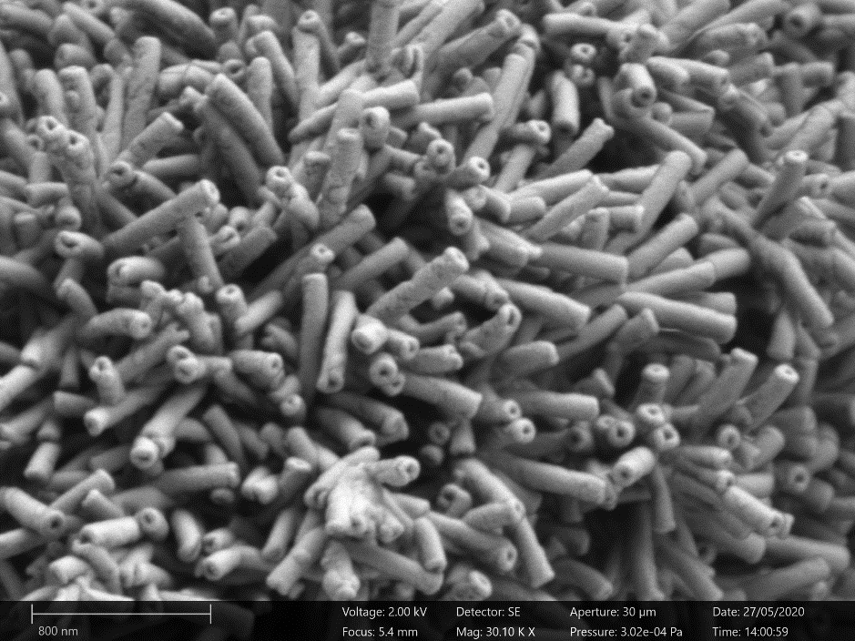

Slide 19
200 µm

Slide 20
90 µm

Slide 21
20 µm

Slide 22
[INSERT A FEW EXAMPLES OF LEARNING FROM MATERIALS FALIURES OR TECHNOLOGIES THAT HAVE BEEN IMPROVED BY MATERIALS SCIENCE]

Slide 23
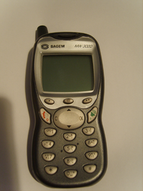
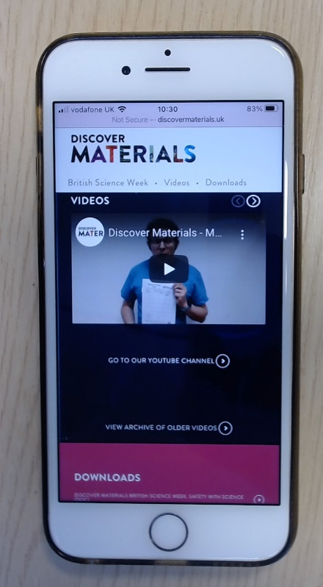
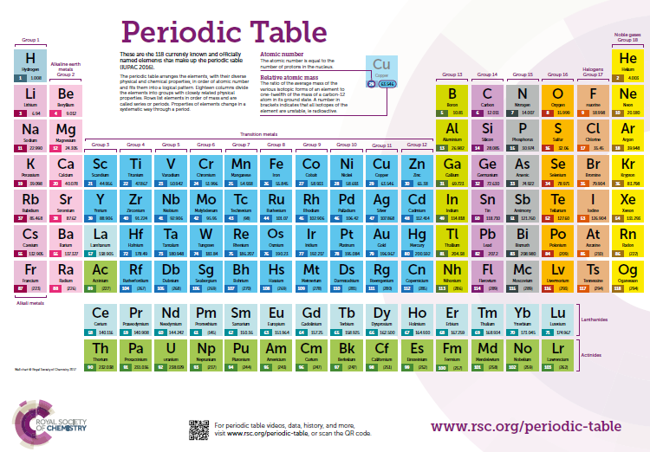
Computing and Communication

Slide 24
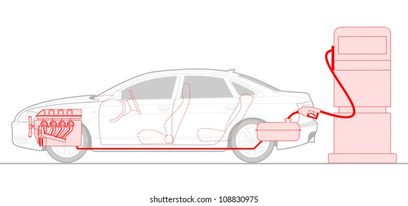
Transport

Slide 25
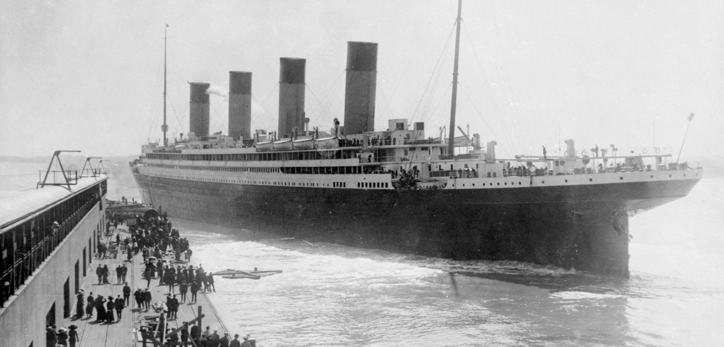
Materials Detectives – The Titanic (1912)
Alamy Stock Photo
Notes:
Titanic; why did it sink? Well obviously it struck an ice berg! But…
Brittle fracture; caused by; low temperature, sulpher content in iron (titanic hull steel had higher content than many other ship hull steels at the time…☹) and impact forces!
Instead of tearing in a ductile way (get a mars bar); actually snapped off and allowed water to enter really suddenly.

Slide 26
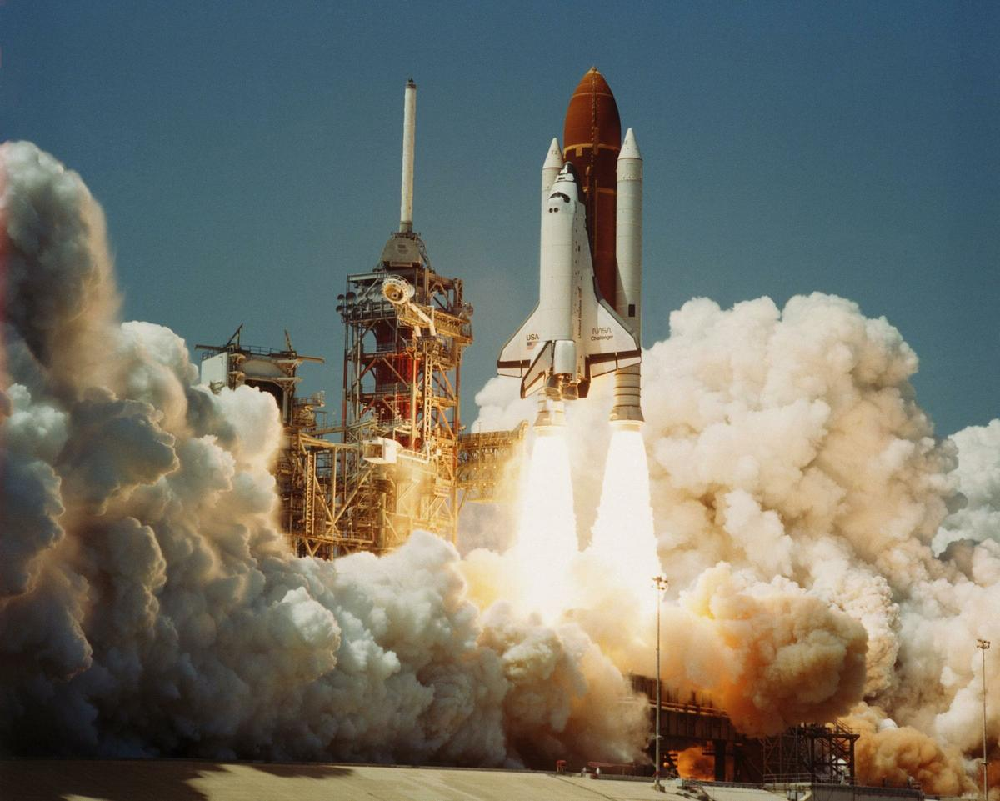
Materials Detective – Space Shuttle Challenger (1986)
The Space Shuttle Challenger Explosion and the O-ring (priceonomics.com)
Notes:
It’s not always metals: space shuttle challenger disaster.
o rings in the RHS booster rocket.? AGAIN it was TOO cold and we had brittle fracture…
What do o rings do? They seal valves; I use them in my experiment to get tight seals and stop air leaking into my set up.
When it’s cold the o ring shrinks and if a gas is pushing through there is then a hot gas leak. This caused a fire in the solid fuel rocket which then caused the external tank to explode and the whole shuttle ripped apart.
Not only a materials failure; also an organisational and data analysis problem; NASA could have known.

Slide 27
Alamy Stock Photo
Material Failures – the Titanic
When the Titanic collided with the iceberg, the hull steel and the wrought iron rivets failed because of brittle fracture. A type of catastrophic failure in structural materials, brittle fracture occurs without prior plastic deformation and at extremely high speeds. The causes of brittle fracture include low temperature, high impact loading, and high sulphur content. On the night of the Titanic disaster, each of these three factors was present: The water temperature was below freezing, the Titanic was travelling at a high speed on impact with the iceberg, and the hull steel contained high levels of sulphur.
Notes:
Titanic; why did it sink? Well obviously it struck an ice berg! But…
Brittle fracture; caused by; low temperature, sulpher content in iron (titanic hull steel had higher content than many other ship hull steels at the time…☹) and impact forces!
Instead of tearing in a ductile way (get a mars bar); actually snapped off and allowed water to enter really suddenly.

Slide 28
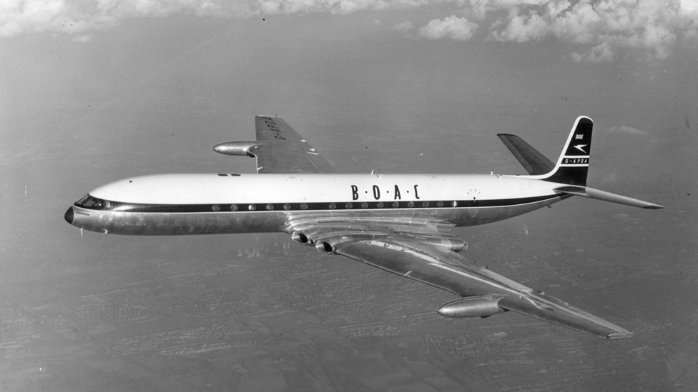
The crashes that changed plane designs forever - BBC Future
Notes:
Why do planes have round windows?
3 crashes; the planes broke into piece around 30 minutes into flight.
Cracking around the sharp corners at doors and windows that became more susceptible to crack over repeated cycles of pressurisation.
De Havilland Comet; fatigue failure; repetitev cycles of force leading to materials becoming more susceptible to sudeen cracking and catastrophic failure.

Slide 29
The Space Shuttle Challenger Explosion and the O-ring (priceonomics.com)
Notes:
It’s not always metals: space shuttle challenger disaster.
o rings in the RHS booster rocket.? AGAIN it was TOO cold and we had brittle fracture…
What do o rings do? They seal valves; I use them in my experiment to get tight seals and stop air leaking into my set up.
When it’s cold the o ring shrinks and if a gas is pushing through there is then a hot gas leak. This caused a fire in the solid fuel rocket which then caused the external tank to explode and the whole shuttle ripped apart.
Not only a materials failure; also an organisational and data analysis problem; NASA could have known.

Slide 30
https://www.youtube.com/watch?v=q_agKY6JJYg (Discover Materials video)

Slide 31
Where can MSE take you?
Lead Materials Engineer, McLaren Automotive
Graduate Materials Engineer, European Space Agency
Materials Engineer,
AWE
Engineer, Bentley Motors
More careers info
www.youtube.com/c/DiscoverMaterials
www.discovermaterials.co.uk
CEO of Space Blue
Graduate Materials Engineer, Dyson

Slide 32
Materials Science and Engineering with a Year in Industry
Materials Science & Engineering (Research)
Nuclear Science and Materials
Materials Science and Engineering with a Foundation Year
Materials Science and Engineering with Corrosion
Materials Science and Engineering with Textile Technology
Chemical and Materials Engineering
Materials Science and Engineering with Polymers
Metallurgy
Automotive Materials
Materials Science and Engineering with Management with Year Abroad
Materials Science and Engineering with Industrial Experience
Aerospace Engineering
Natural Sciences
Biomedical Materials Science
Materials Science and Engineering with Biomaterials
Biomaterials Science and Engineering
Materials Engineering with an International Foundation Year
Materials Science and Engineering with Metallurgy
Materials Science and Engineering with Management with Industrial Experience
Mechanical and Materials Engineering
Materials Science & Engineering
Materials Science and Engineering with Management
Materials Science with Nuclear Engineering

Slide 33
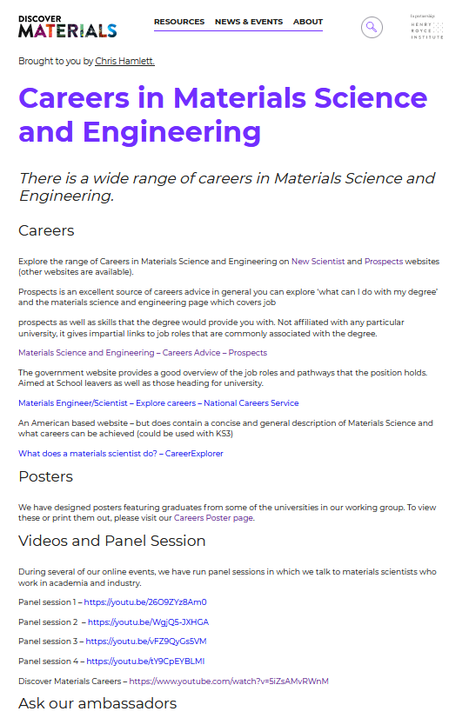
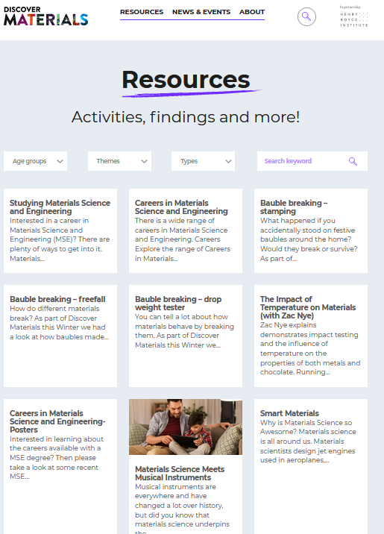
Where to find out more ?
www.discovermaterials.co.uk

Slide 34
Let’s Move to the Moon!!

Slide 35
Mission 0
https://youtu.be/Lm11qxt2LRk

Slide 36
Good luck

