Slide 1
Let’s Move to the Moon
12th December 2022

Slide 2
Message from Ground Control……

Slide 4
Message from Ground Control……
https://youtu.be/fuxiIIl3E6U

Slide 5
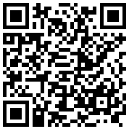
What materials would you take to the moon?
1) Work in your groups to design a poster that should include:
The materials you would take to the moon
What those materials will be used for
(their application(s) )
Why you chose those materials
(the properties of the material)
2) Upload a photo of your poster
Ask an ambassador to do it if you don’t have a phone

Slide 6
Time to Blast Off!!
This Photo by Unknown Author is licensed under CC BY-SA

Slide 7
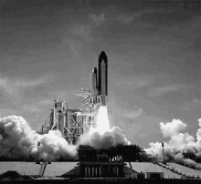
Time to Blast Off!!

Slide 8
Thank you!

