Slide 2
These slides are some examples of objects seen through a magnifying glass (x6 magnification) and a clip-on microscope lens attached to a smart phone (x60 magnification).

Slide 3
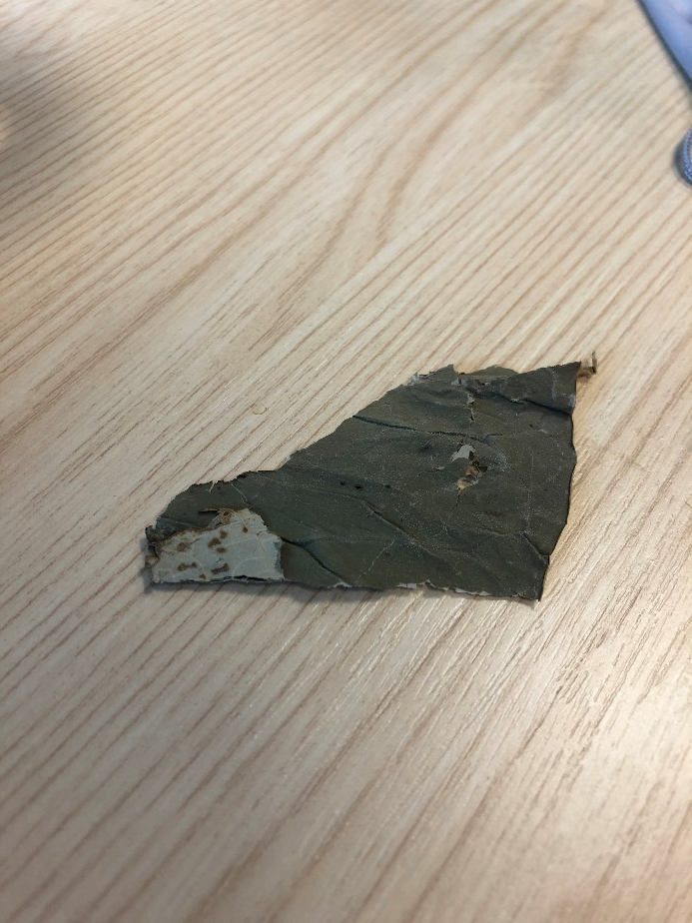
Lotus leaf
No lens

Slide 4
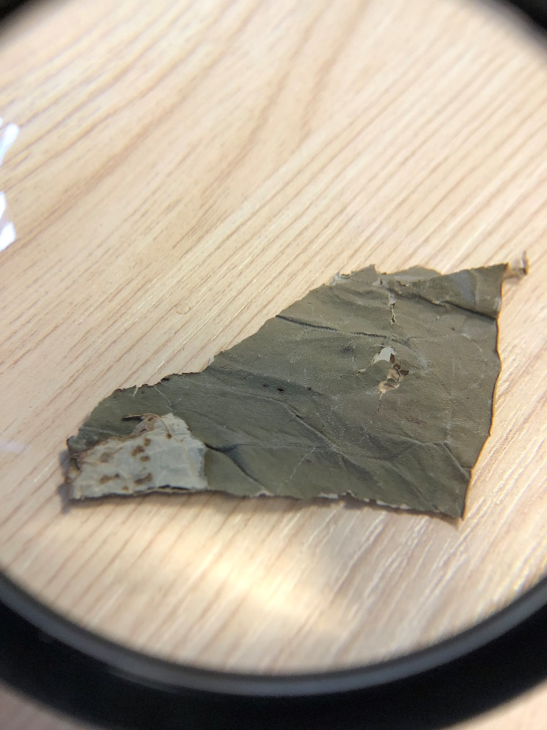
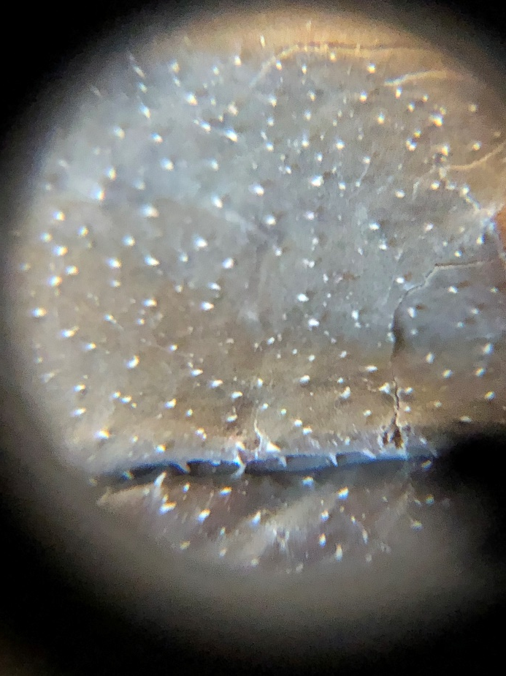
Lotus leaf
No lens
Magnifying glass (x 6)
Clip on microscope lens (x 60)

Slide 5
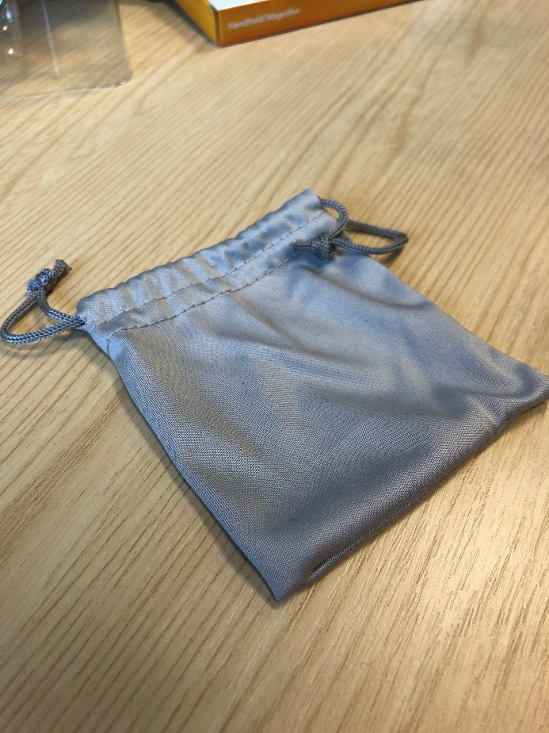
Fabric bag
No lens

Slide 6
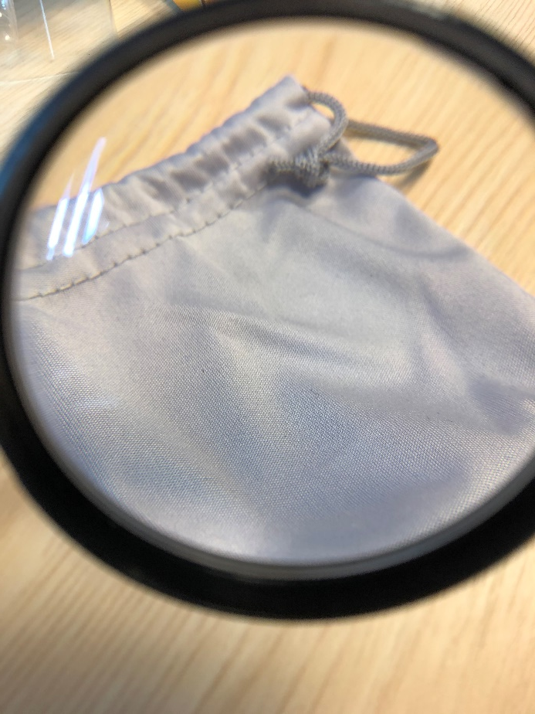
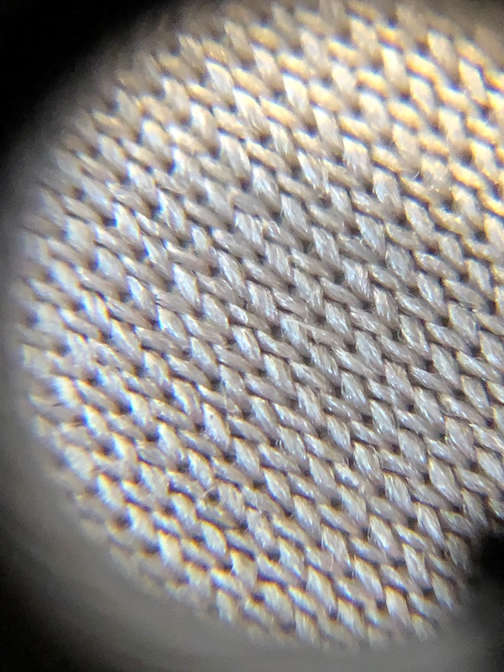
Fabric bag
No lens
Magnifying glass (x 6)
Clip on microscope lens (x 60)

Slide 7
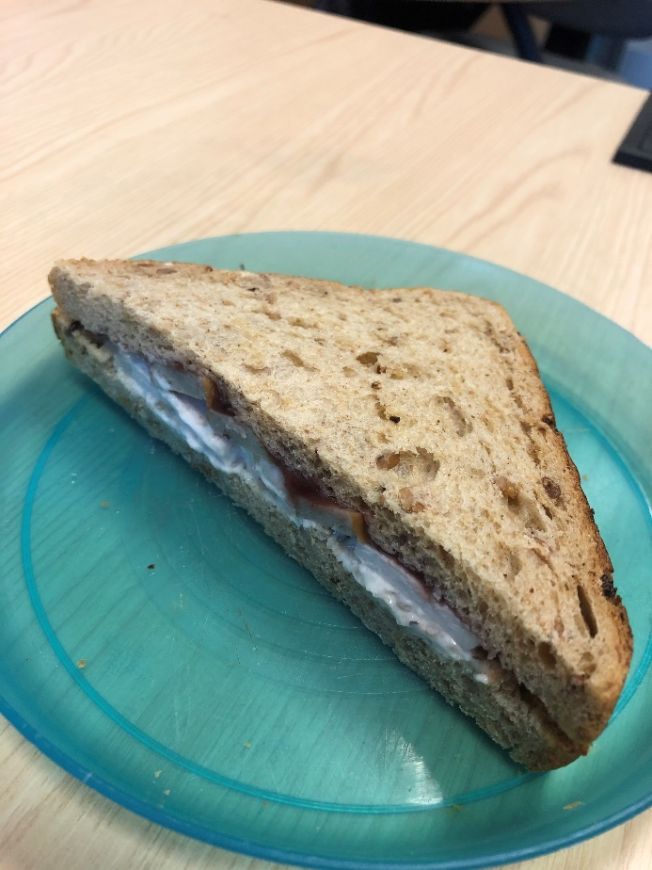
Sandwich
No lens

Slide 8
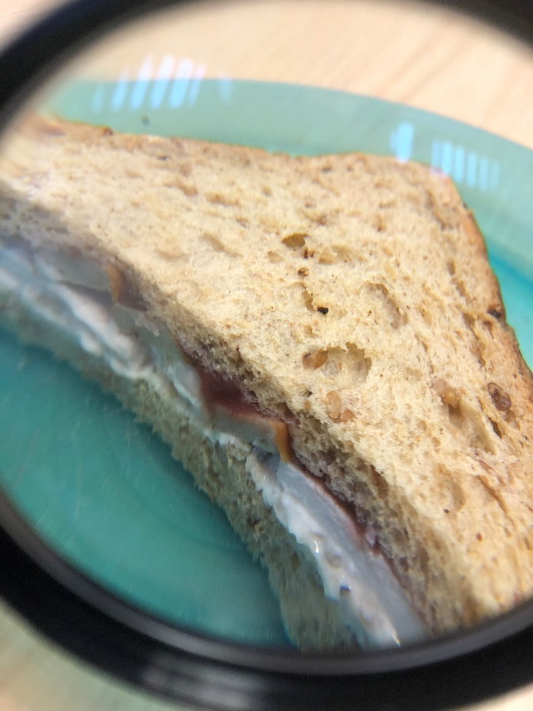
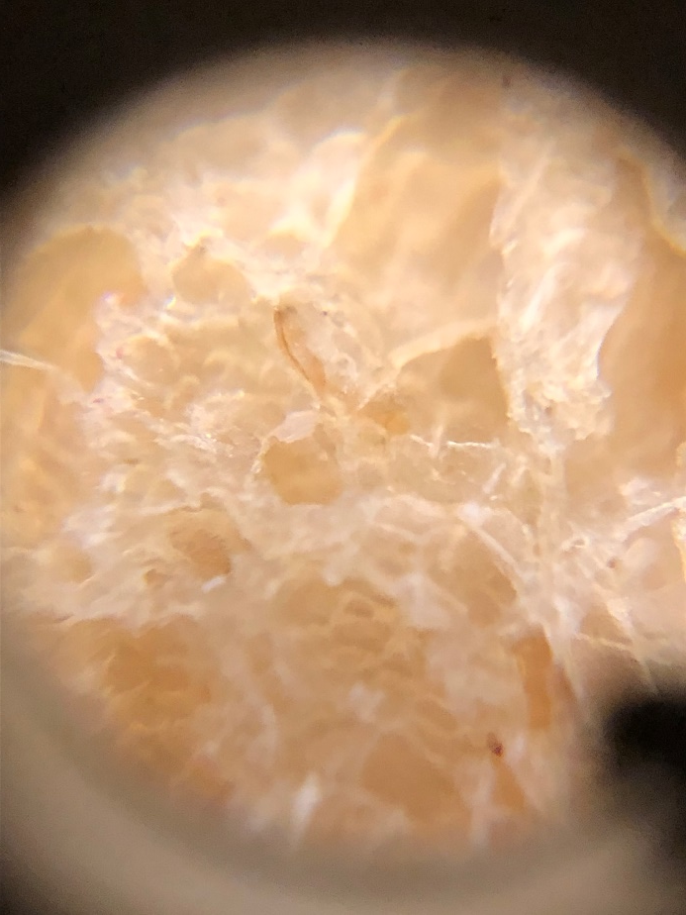
Sandwich
No lens
Magnifying glass (x 6)
Clip on microscope lens (x 60)

Slide 9
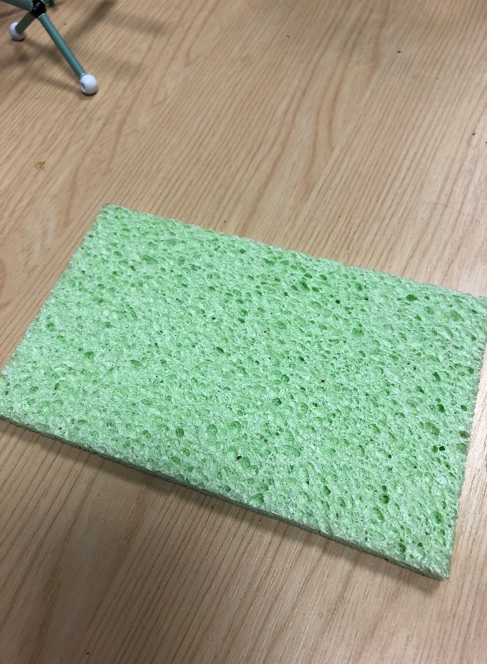
Sponge
No lens

Slide 10
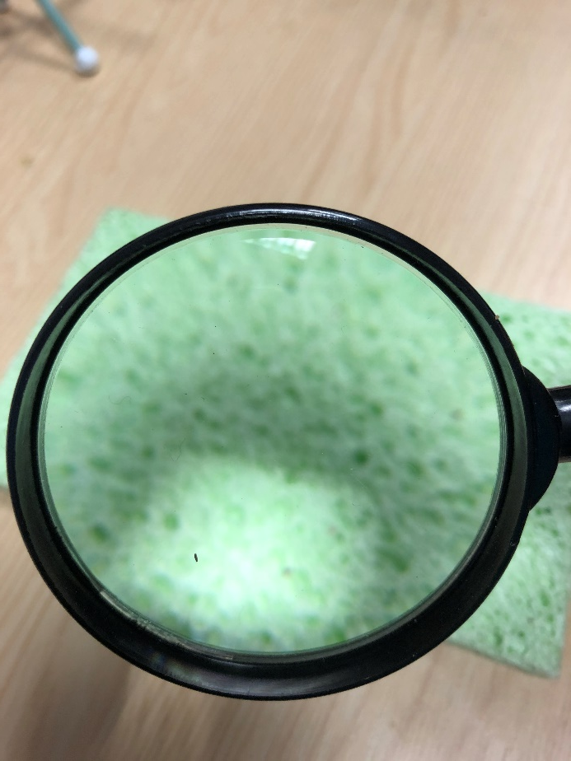
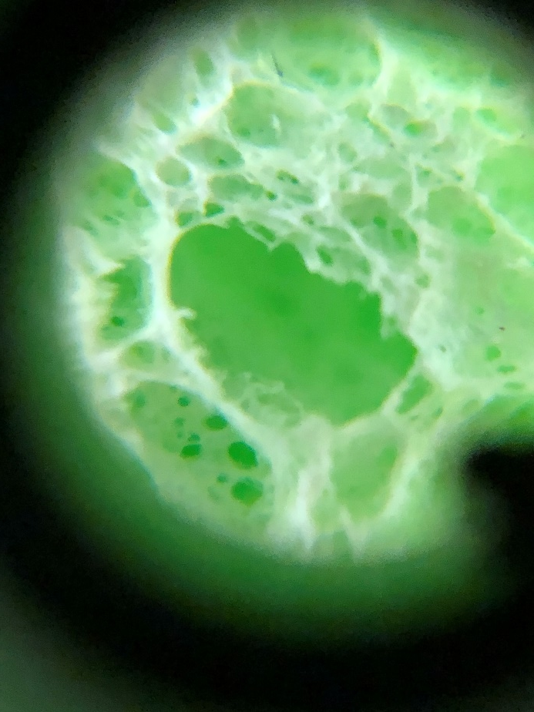
Sponge
No lens
Magnifying glass (x 6)
Clip on microscope lens (x 60)

Slide 11
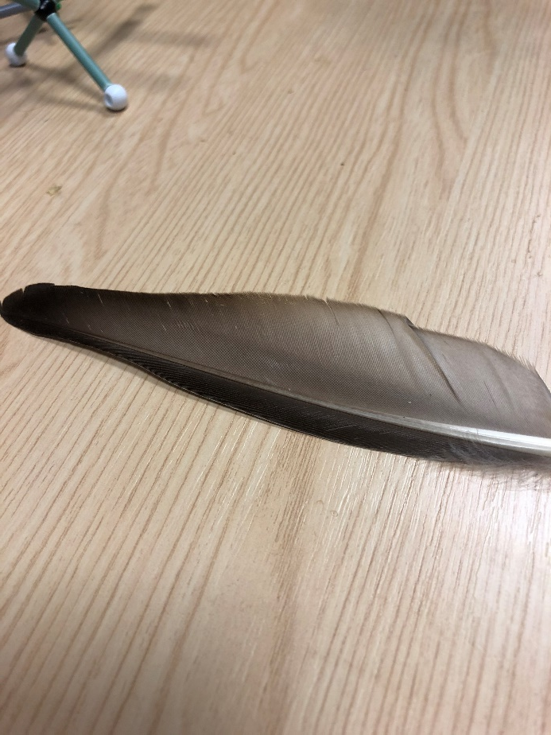
Duck feather
No lens

Slide 12
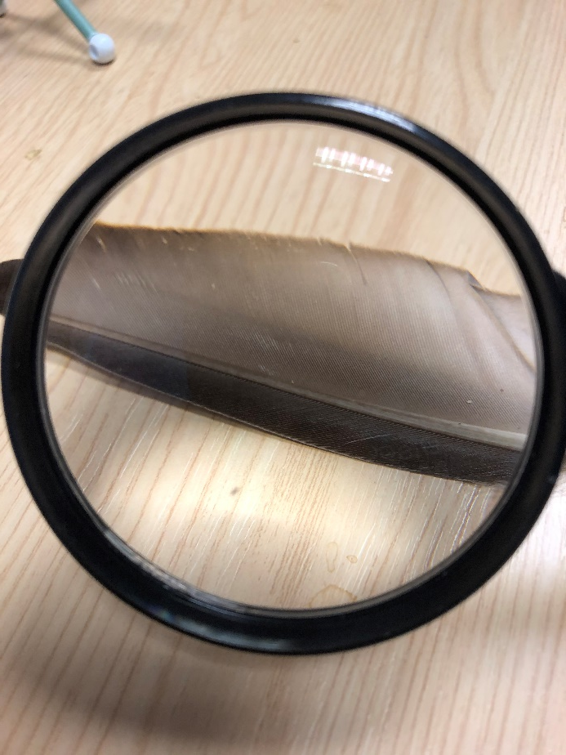
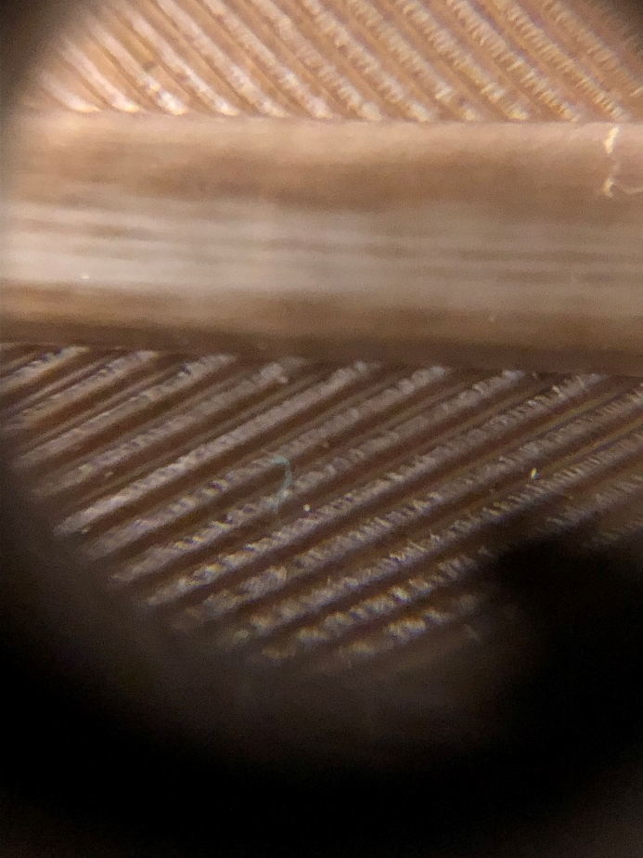
Duck feather
No lens
Magnifying glass (x 6)
Clip on microscope lens (x 60)

Slide 13
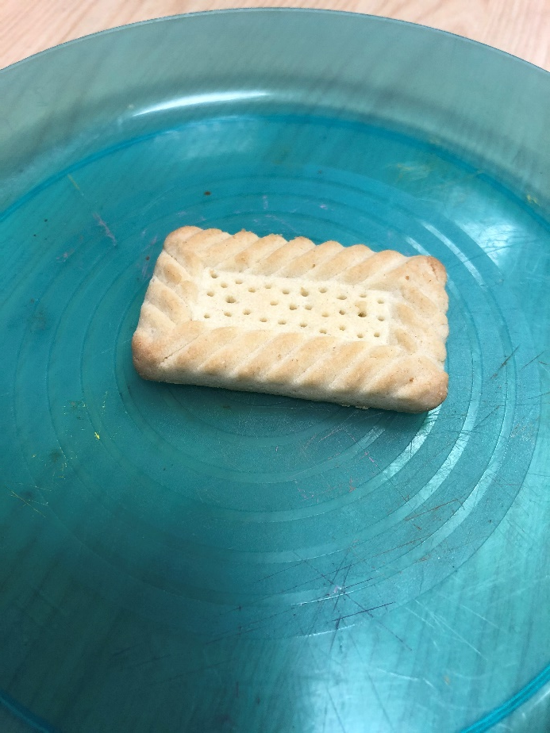
Shortcake biscuit
No lens

Slide 14
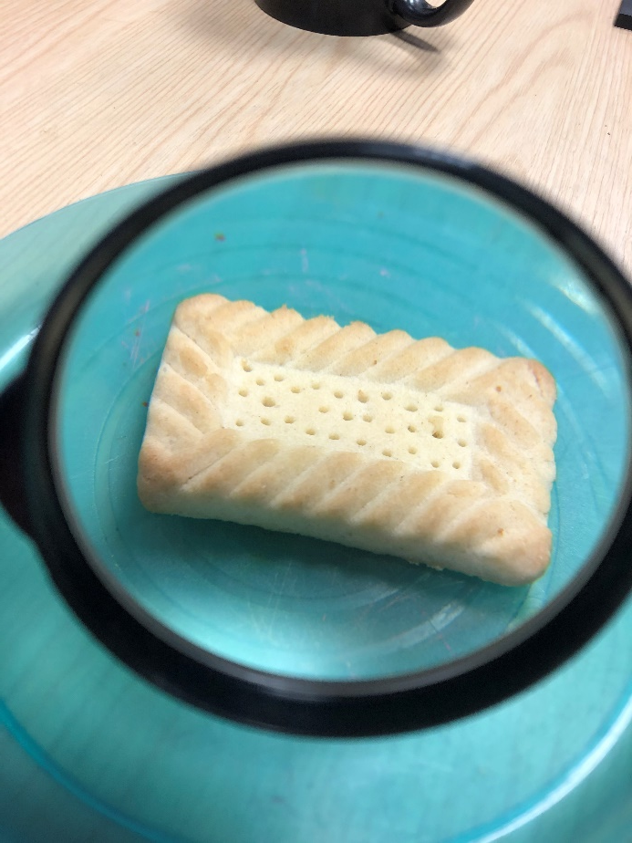
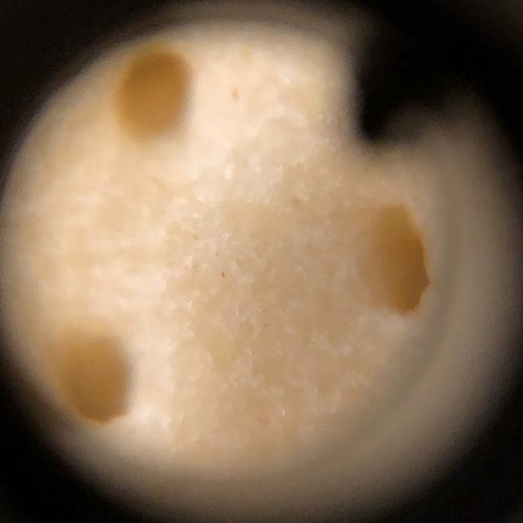
Shortcake biscuit
No lens
Magnifying glass (x 6)
Clip on microscope lens (x 60)

Slide 15
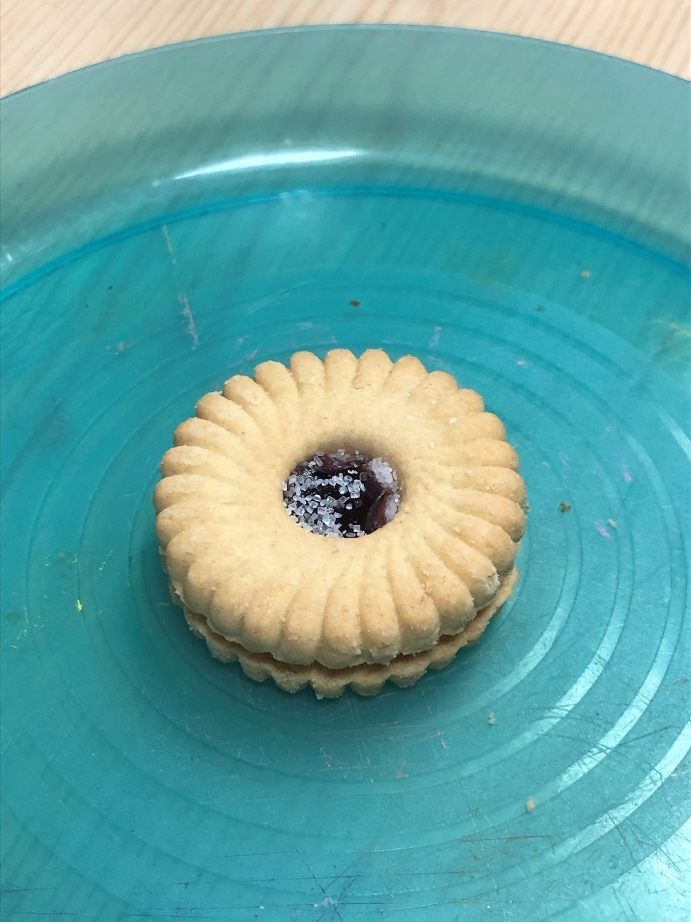
Jam ring biscuit
No lens

Slide 16
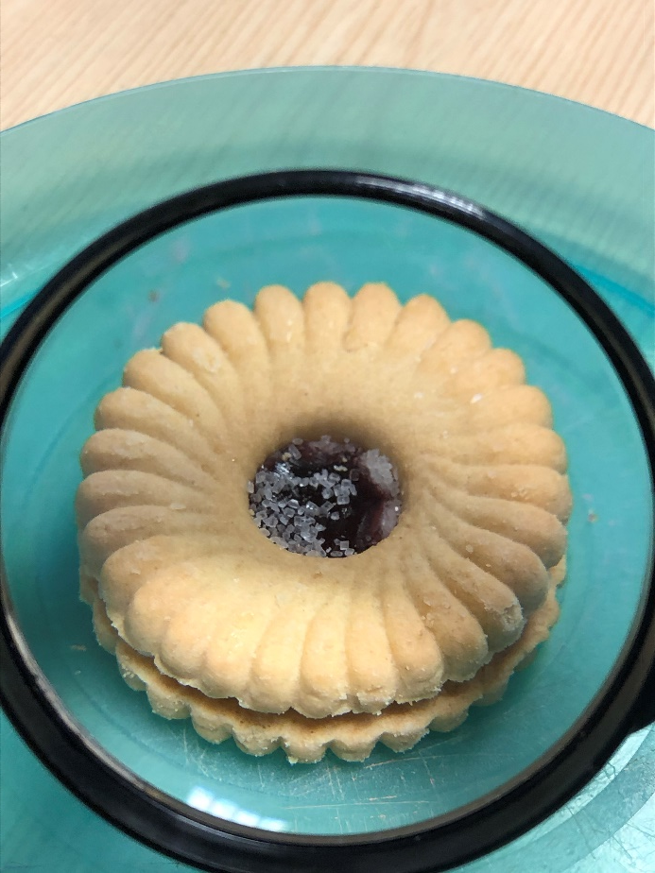
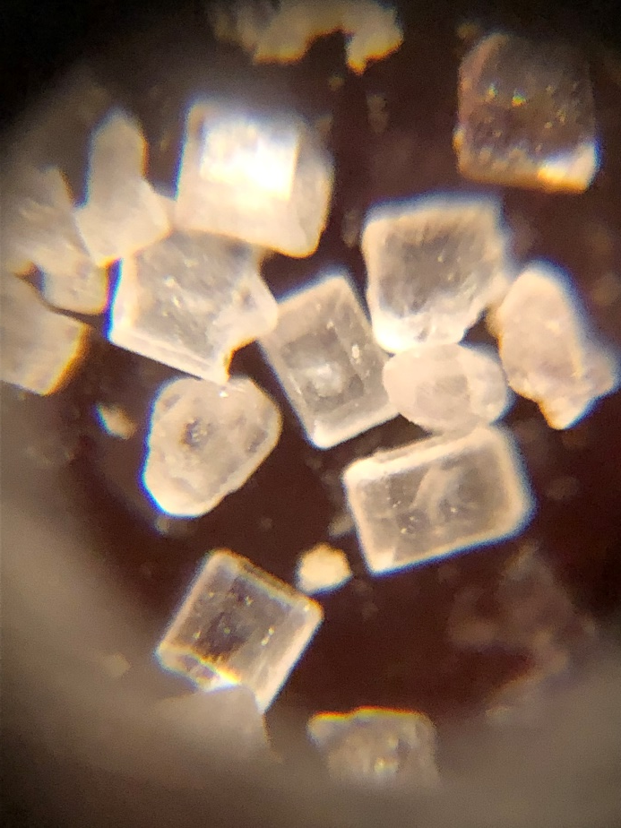
Jam ring biscuit
No lens
Magnifying glass (x 6)
Clip on microscope lens (x 60)

Slide 17
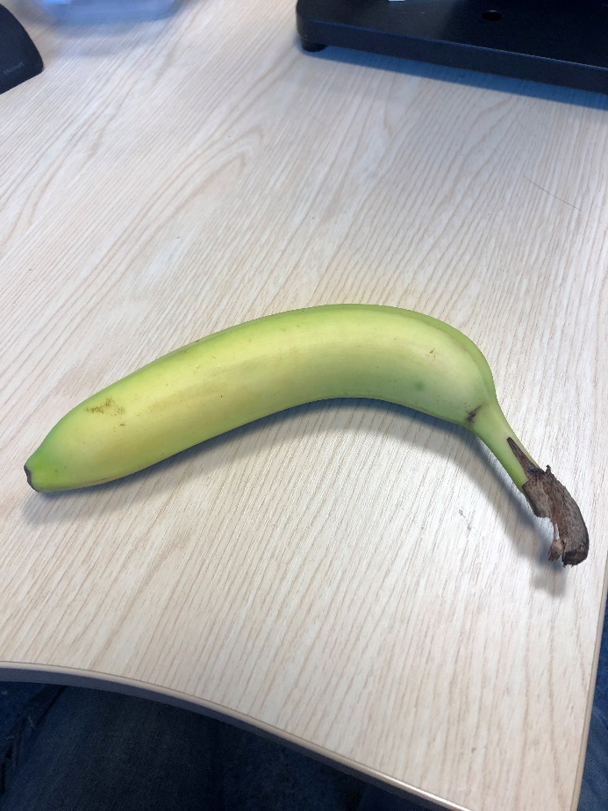
Banana
No lens

Slide 18
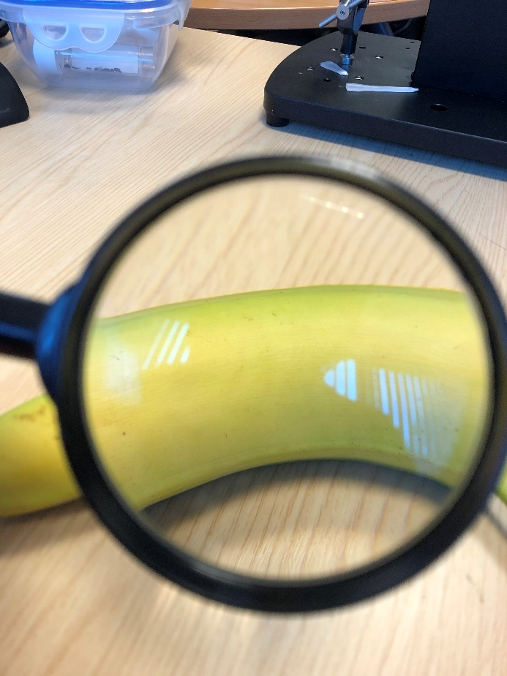
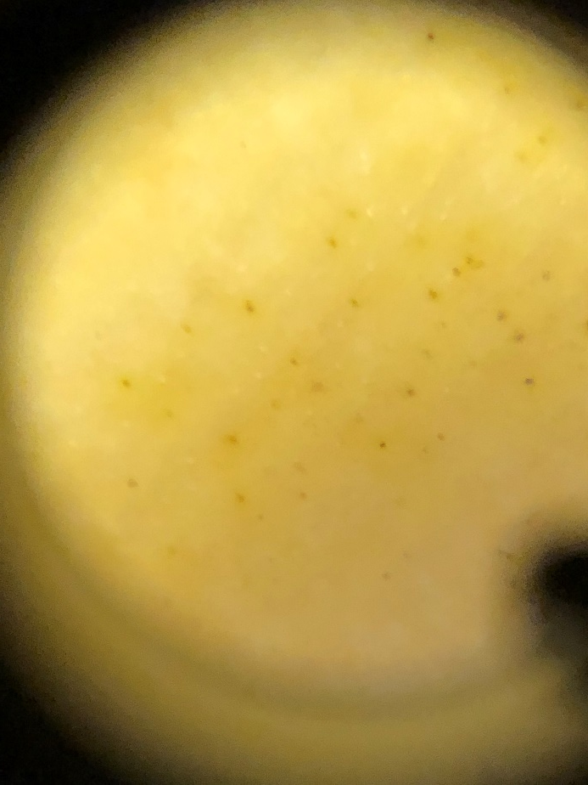
Banana
No lens
Magnifying glass (x 6)
Clip on microscope lens (x 60)

Slide 19
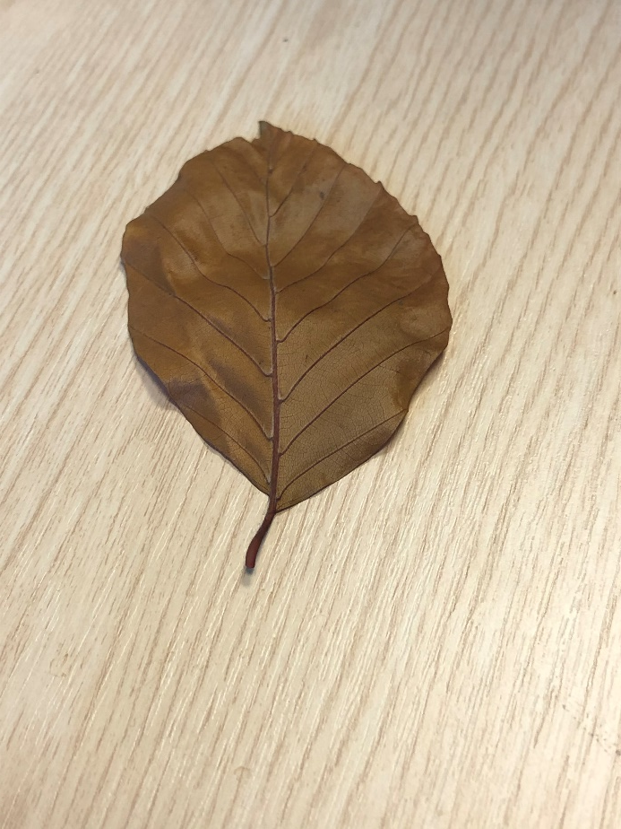
Beech leaf
No lens

Slide 20
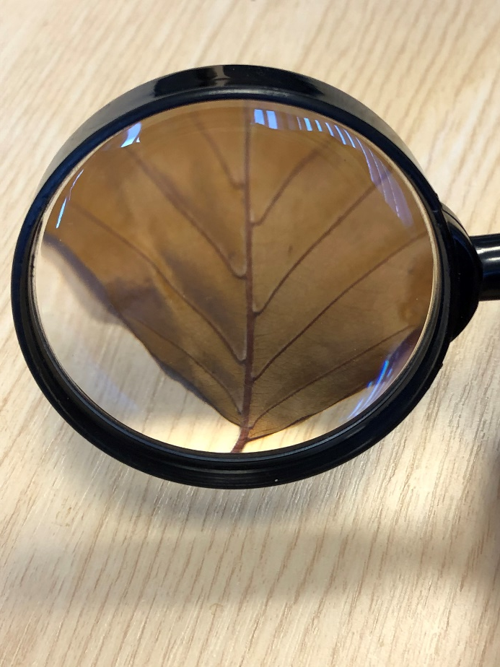
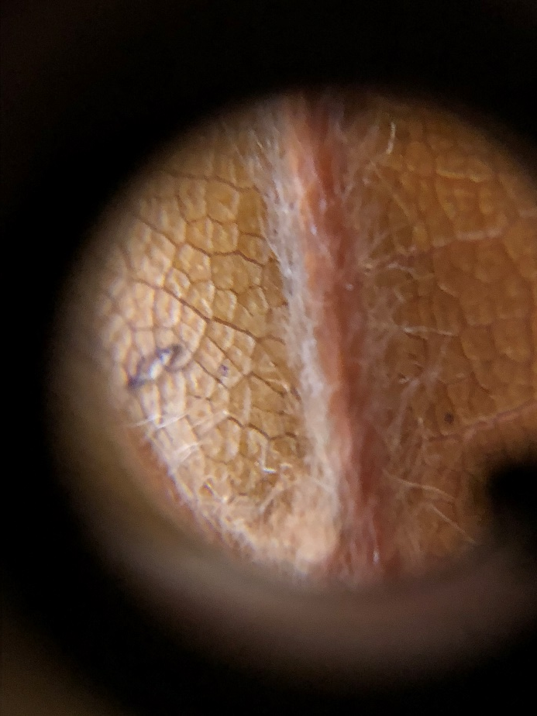
Beech leaf
No lens
Magnifying glass (x 6)
Clip on microscope lens (x 60)

Slide 21
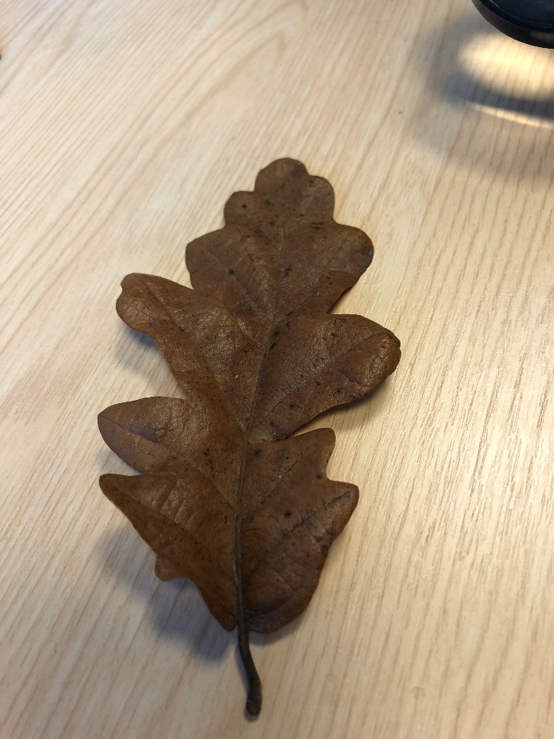
Oak leaf
No lens

Slide 22
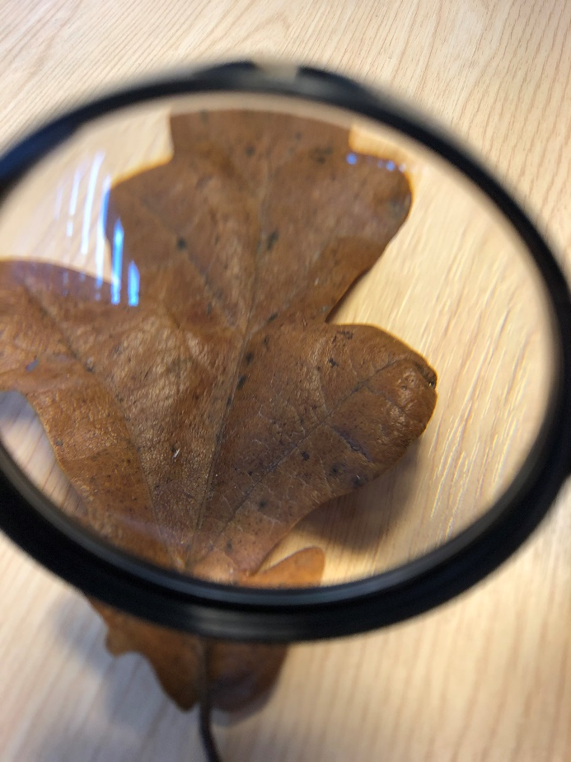
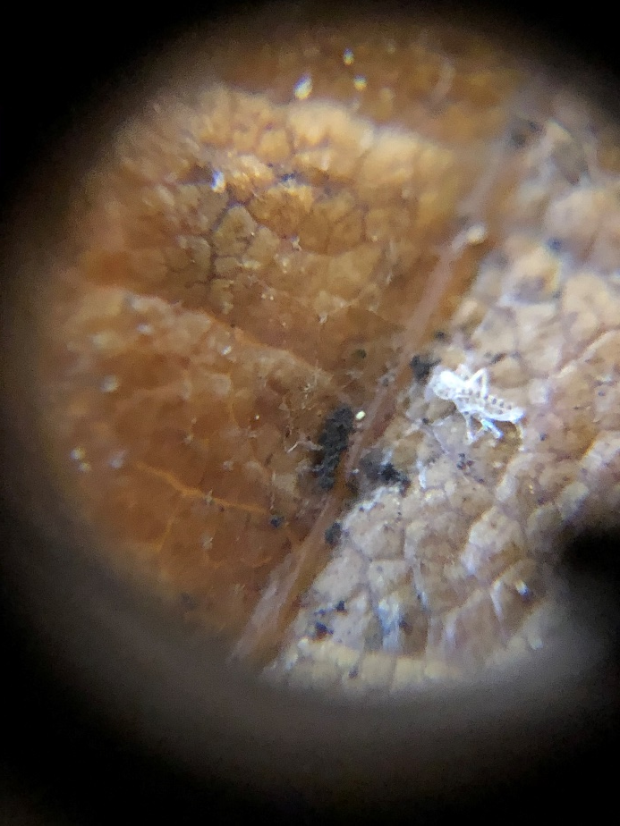
Oak leaf
No lens
Magnifying glass (x 6)
Clip on microscope lens (x 60)

Slide 23
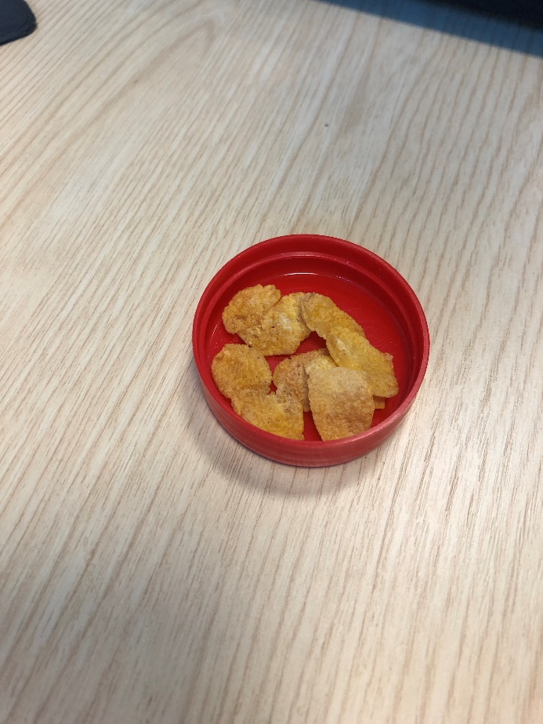
Cornflakes
No lens

Slide 24
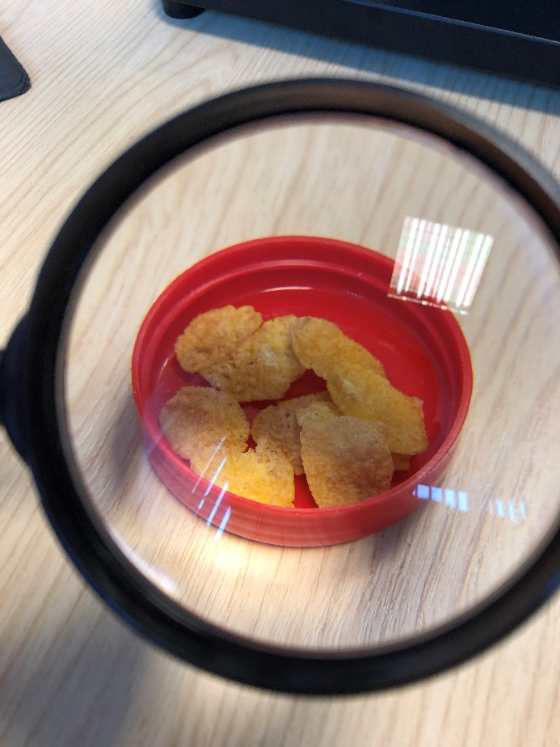
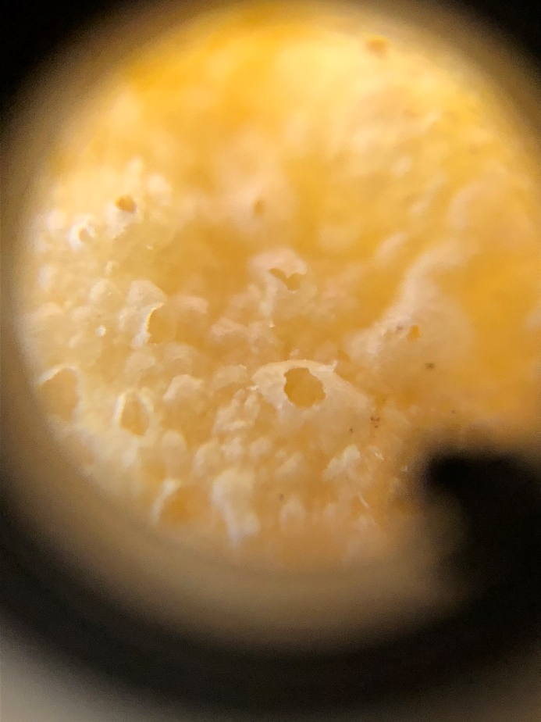
Cornflakes
No lens
Magnifying glass (x 6)
Clip on microscope lens (x 60)

Slide 25
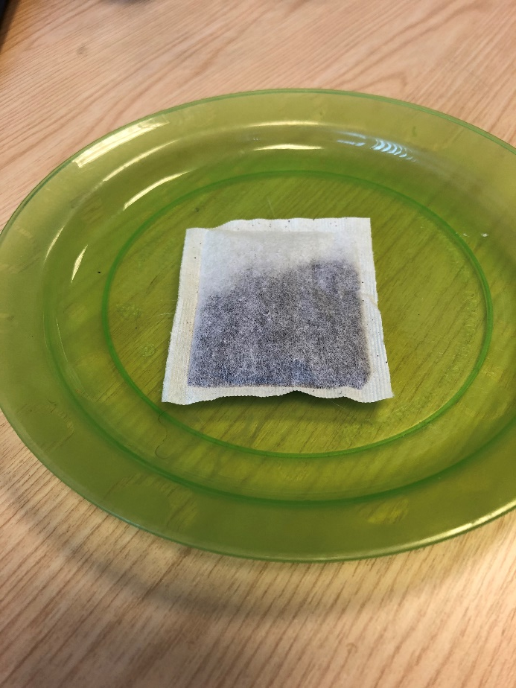
Teabag
No lens

Slide 26
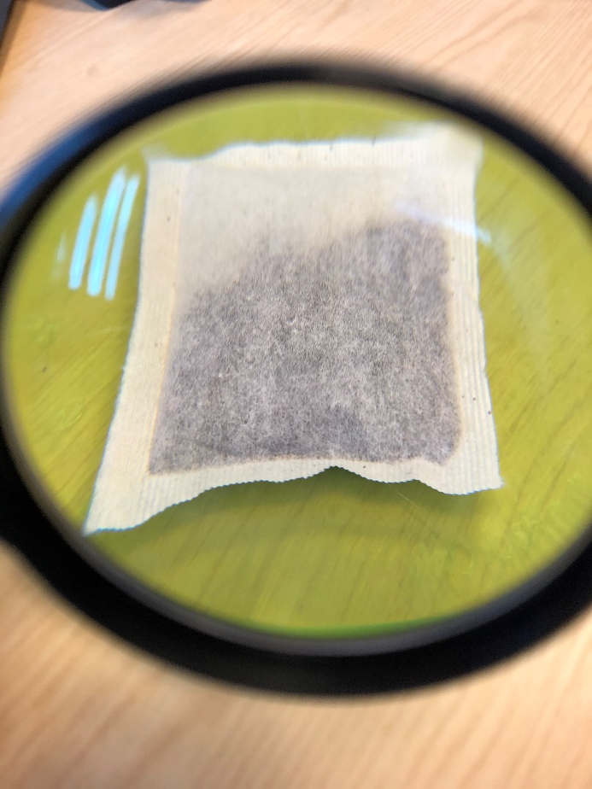
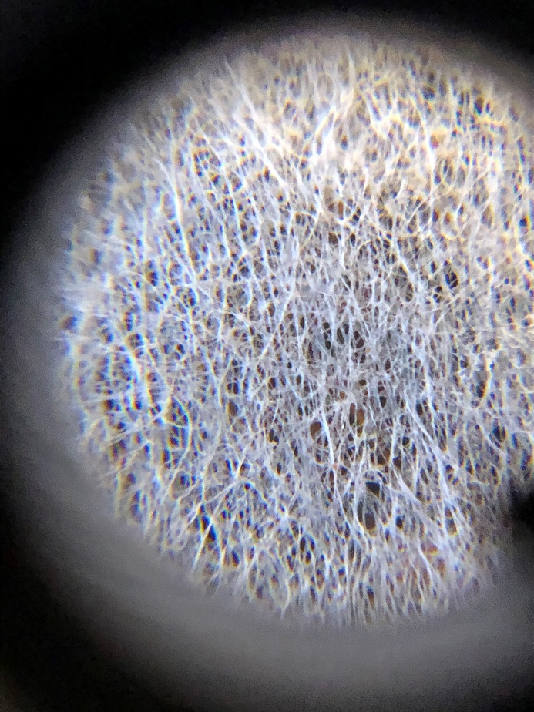
Teabag
No lens
Magnifying glass (x 6)
Clip on microscope lens (x 60)

Slide 27
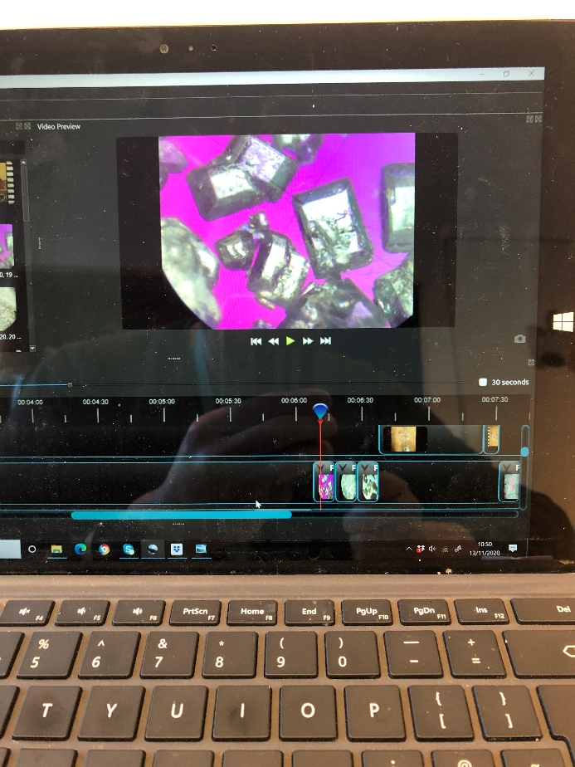
Laptop screen
No lens

Slide 28
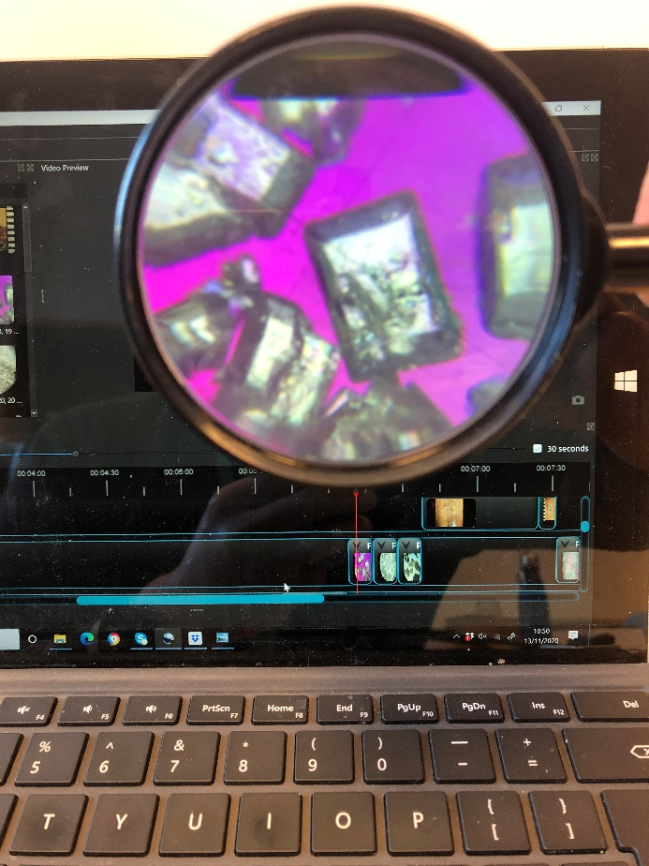
Laptop screen
No lens
Magnifying glass (x 6)
Clip on microscope lens (x 60)

Slide 29
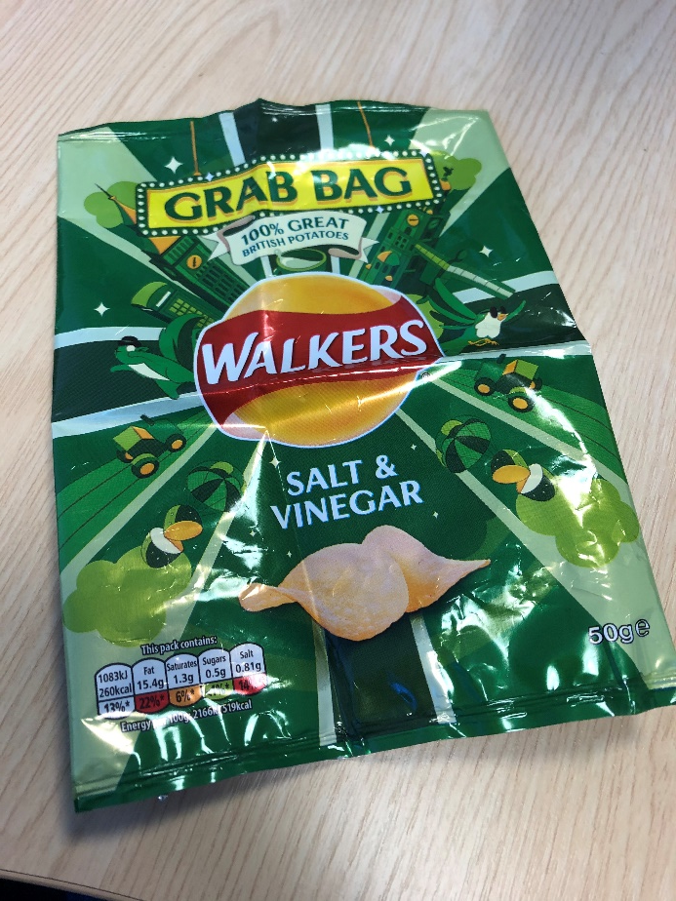
Crisp packet
No lens

Slide 30
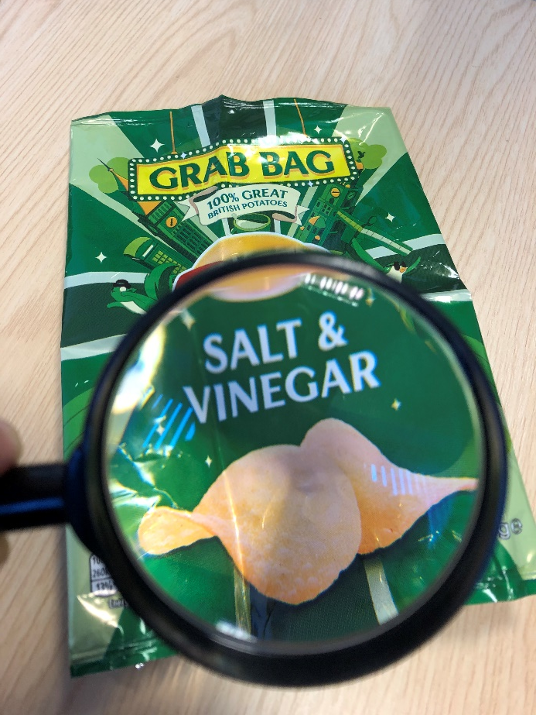
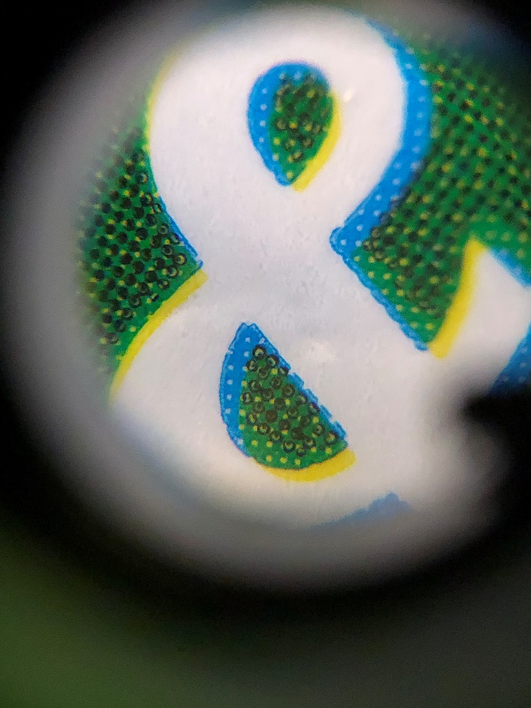
Crisp packet
No lens
Magnifying glass (x 6)
Clip on microscope lens (x 60)

